Slide 1
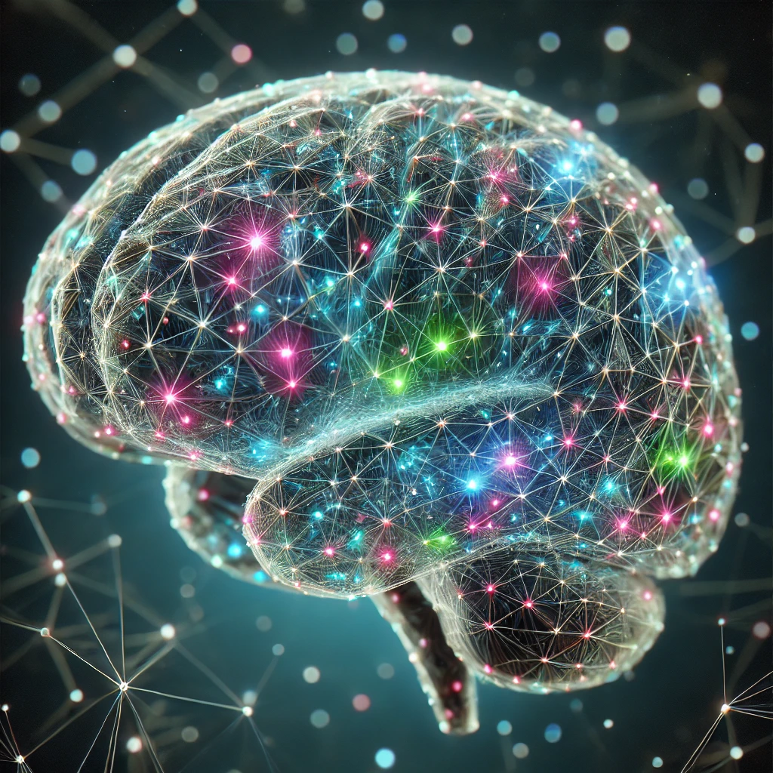
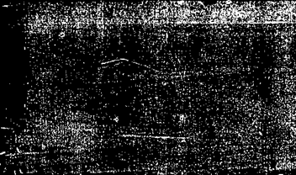
BRAIN TUMOR CLASSIFICATION USING MR IMAGES AND TRANSFER LEARNING
GOWTHAM SAI REDDY MADDIREDDY-700759075
Manu Gupta, Gangadi Shirisha, Aela Mani Chandana, Belide Ankitha
Published on-19 July 2023
LINK:-Brain Tumor Classification using MR Images and Transfer Learning | IEEE Conference Publication | IEEE Xplore

Slide 2
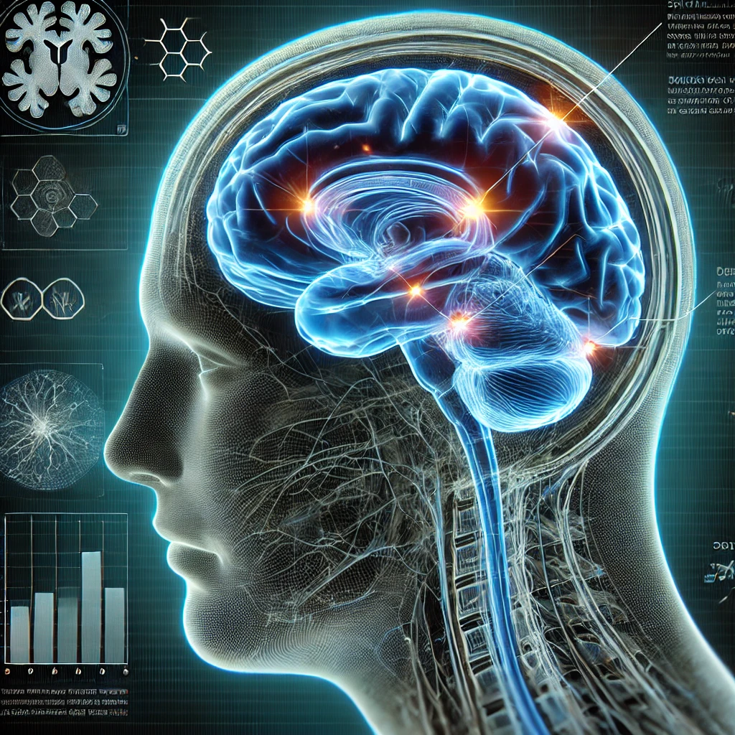
MOTIVATION
Real-time detection of brain tumors can be accomplished using various imaging methods, including magnetic resonance imaging (MRI), computed tomography (CT), and positron emission tomography (PET) scans.
Magnetic resonance imaging (MRI) is the most widely used technique for detecting brain tumors, utilizing a magnetic field and radio waves to generate detailed brain images. Computed tomography (CT) scans employ X-rays to capture brain images, while positron emission tomography (PET) scans use a radioactive tracer to assess brain function..
The real-time detection of brain tumors offers several benefits for doctors. It enables them to swiftly determine the tumor's location and size, aiding in treatment planning. Additionally, real-time imaging can assist surgeons during procedures, allowing for precise tumor removal while reducing harm to healthy brain tissue.
Furthermore, continuous real-time monitoring of the tumor during and after treatment enables doctors to assess treatment effectiveness and make necessary modifications. In general, real-time brain tumor detection plays a crucial role in both diagnosis and treatment.

Slide 3
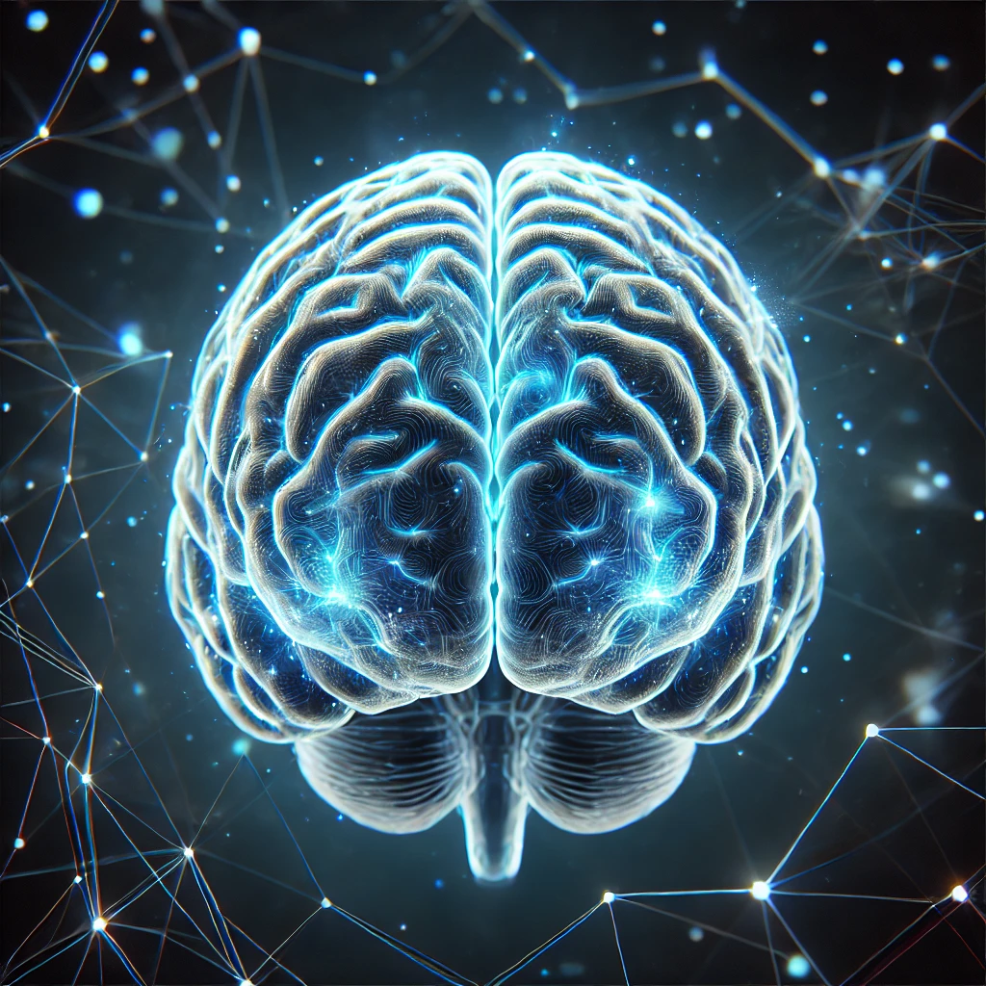
PROBLEM STATEMENT
Brain tumors are among the most life-threatening conditions, making early detection essential for effective treatment. Magnetic Resonance Imaging (MRI) is widely used for detecting brain tumors due to its ability to provide detailed images of soft tissues. However, manually classifying brain tumors from MR images can be a slow, subjective process and is susceptible to human error. The key challenge lies in developing an automated and accurate method for brain tumor classification using MR images. Traditional machine learning models rely on large labeled datasets and extensive feature engineering, which can be challenging in medical image analysis. Transfer learning, a deep learning technique that leverages pre-trained models, presents a promising solution by utilizing knowledge from large datasets to enhance classification accuracy on smaller, specialized medical datasets.

Slide 4

OBJECTIVE
Our objective is to build a system that works with Convolution Neural Network using Transfer Learning Techniques. The model is trained with augmentation methods and generate good accuracy among all the transfer learning and predefined architectures. In transfer learning algorithms based on highly complex neural network that mimic the human brain works to detect patterns in large unstructured data set. Transfer Learning can analyze images, videos, and unstructured data in which machine learning can’t easily do. The model is able to achieve high accuracy on the target dataset, while still being computationally efficient.

Slide 5
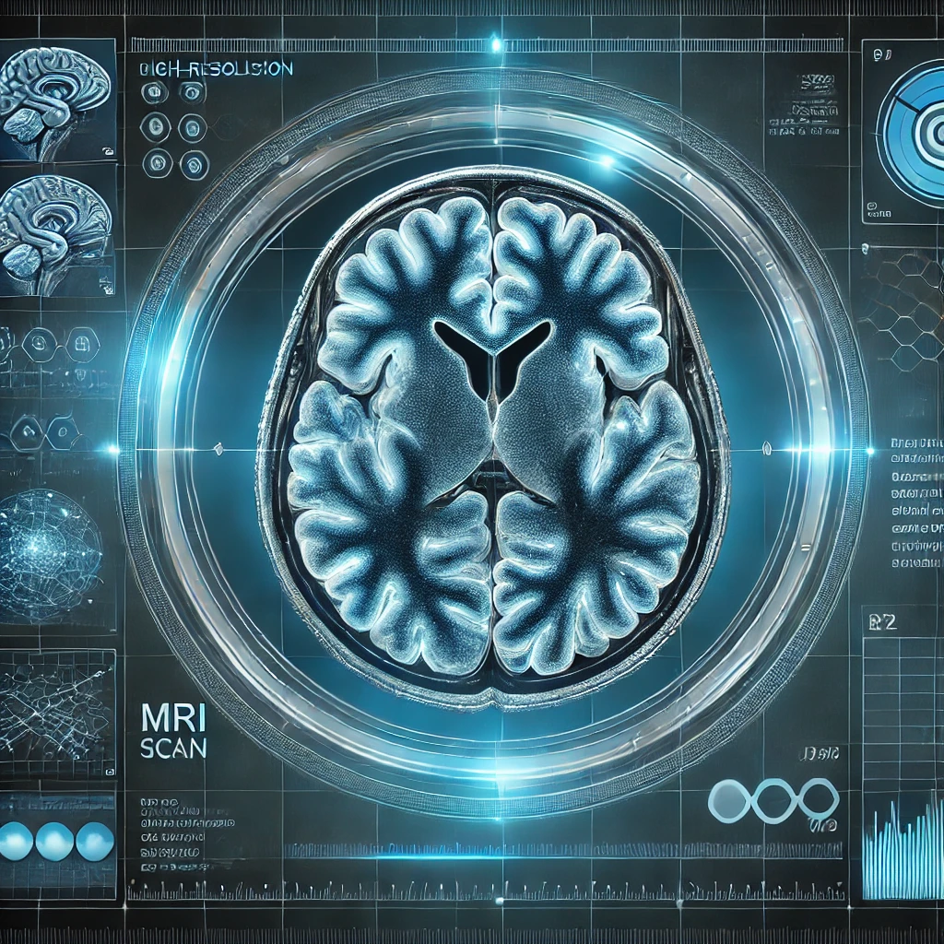
CONTRIBUTIONS
Advances in Medical Imaging Analysis: Transfer learning improves the ability to detect and classify brain tumors from MR images with high accuracy. Reduces the need for manual analysis, helping radiologists make quicker, more reliable decisions.
Improved Tumor Classification: Helps in distinguishing between different types of brain tumors, such as gliomas, meningiomas, and pituitary tumors. Early Detection: Facilitates early diagnosis and treatment planning, potentially improving patient outcomes.
Contribution to Personalized Medicine: Accurate classification aids in developing tailored treatment strategies based on the specific type and grade of the tumor.

Slide 6

MODEL IMPLEMENTION
Loading the dataset: The first step is to load the dataset into memory. This can be done using Python libraries such as NumPy or Pandas. The dataset should be divided into training and test sets.
Augmentation and image pre-procesing: Data augmentation techniques such as and cropping can be used to artificially increase the size of the dataset and reduce overfitting. This step can be done using Python libraries such as Keras or OpenCV.
Feature extraction: Feature extraction involves extracting important features from the images that can help in distinguishing between different types of tumors. This can be done using pre-trained models such as VGG16 or InceptionV3, which have been trained on large datasets of images and can extract meaningful features from the input images.
Classification: Once the features have been extracted, a classification model can be trained to classify the images into different tumor types.
Further classification of tumor type: After the images have been classified into different tumor types, further classification can be done to identify the specific type of tumor.
Overall, this process involves loading the dataset, augmenting the data, extracting important features, classifying the images to identify if there is a tumor or not, and further classifying the specific types of tumor if there is a tumor. This process requires a combination of image processing, machine learning, and deep learning techniques and can be computationally intensive.

Slide 7
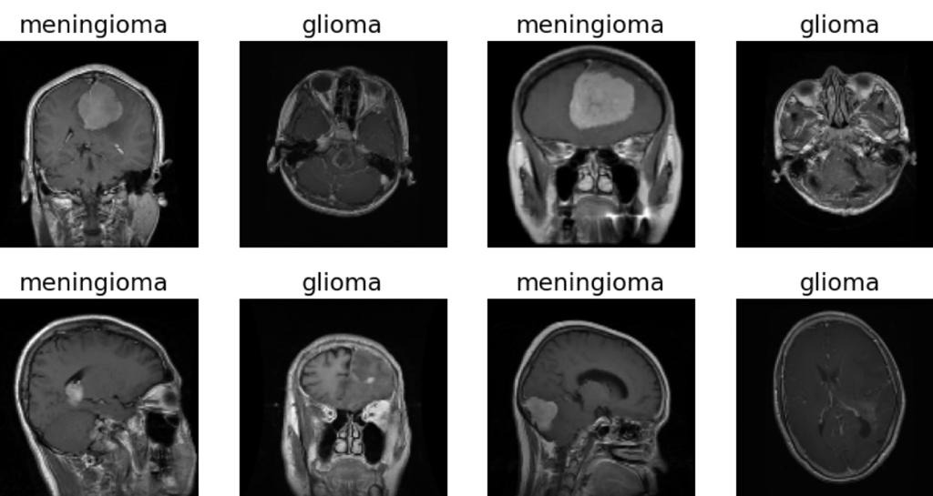
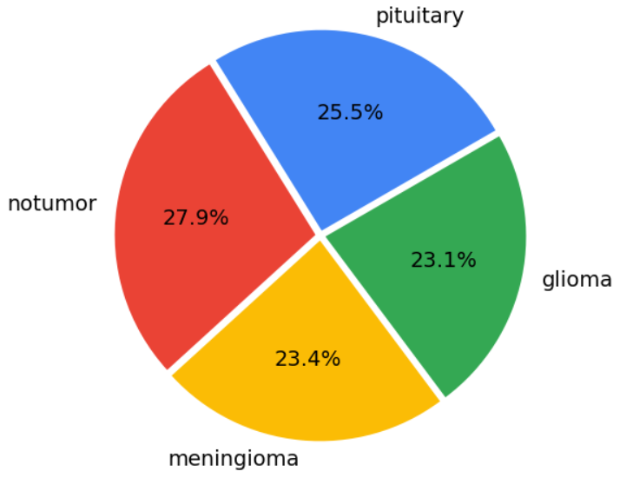
DATA DESCRIPTION
There were 4 distinct classes in the dataset — Glioma, Meningioma, Pituitary Tumor, and a baseline case of No Tumor. The dataset consists of 5,712 images in the training set and 1,311 images in the test set.
Sample Images:

Slide 8
Performance metrics
The metrics we have used for the evaluation of our model are:
Accuracy= (TN+TP)/ (TN+FP+FN+TP) (1)
Precision=TP/ (FP+TP) (2)
Recall=TP/ (TP+FN) (3)
F1 score= TP/ (TP+1/2(FP+FN)) (4)
Where,
TP = True-positive,
TN = True-negative,
FP = False- positive,
FN = False-negative
PERFORMANCE METRICS

Slide 9
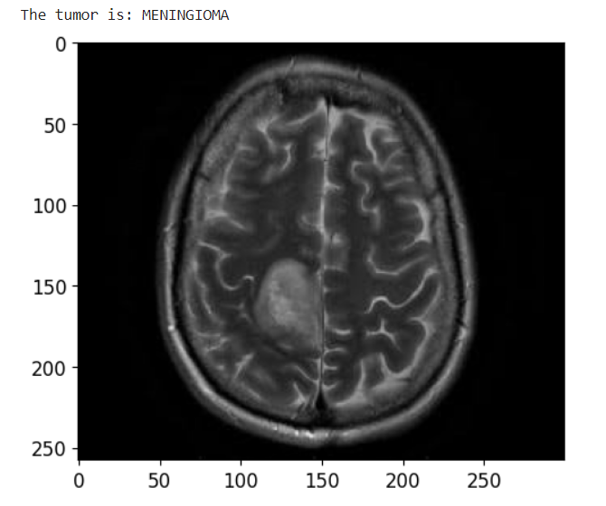
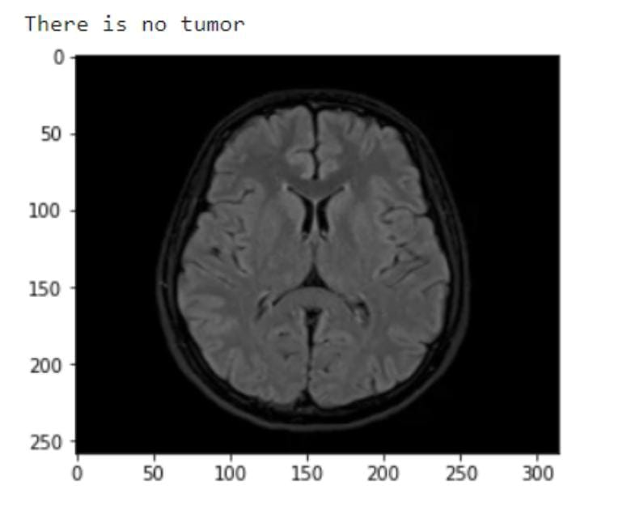
RESULTS
The MR image is predicted correctly as expected. The image is displayed after the prediction with the label on the top of the image as result.

Slide 10
COMPARISION OF RESULTS
Epochs | Three |  | Five |  | Seven |  | Ten
 | Time | Accuracy | Time | Accuracy | Time | Accuracy | Time | Accuracy
CNN | 165 | 75% | 175 | 80% | 179 | 80% | 171 | 86%
VGG-16 | 181 | 90% | 179 | 97% | 181 | 97% | 176 | 98%
InceptionV3 | 184 | 83% | 173 | 87% | 221 | 87% | 183 | 90%

Slide 11
CONCLUSION
Within the proposed work, a model for brain tumor classification is displayed utilizing CNN and transfer learning procedures.
The outcomes proposed that VGG16 model gives way better comes about in comparison to CNN and InceptionV3 with accuracy of 98% on the test dataset.
This show is computationally successful, less time expending and gives strong design for classification of brain tumors.
In future scope, the tumor discovery can be performed utilizing multimodal MRI pictures for moved forward execution.

Slide 12
REFERENCES
[1] A. Çinar and M. Yildirim, ‘‘Detection of tumors on brain MRI images using the hybrid convolutional neural network architecture,’’ Med. Hypotheses, vol. 139, Jun. 2020, Art. no. 109684.
[2] H. M. Rai and K. Chatterjee, ‘‘Detection of brain abnormality by a novel Lu-Net deep neural CNN model from MR images,’’ Mach. Learn. Appl., vol. 2, Dec. 2020, Art. no. 100004.
[3] M. K. Islam, M. S. Ali, M. S. Miah, M. M. Rahman, M. S. Alam, and M. A. Hossain, “Brain tumor detection in MR image using superpixels, principal component analysis and template based K-means clustering algorithm,’’ Mach. Learn. Appl., vol. 5, Sep. 2021, Art. no. 100044
[4] R. Mehrotra, M. A. Ansari, R. Agrawal and R. S.Anand, “A Transfer Learning approach for AIbased classification of brain tumors,” Mach. Learn. Appl. 2020, 2, 10–19.
[5] T. K. Das, P. K. Roy, M. Uddin, K. Srinivasan, C.-Y. Chang, and S. Syed-Abdul, ‘‘Early tumor diagnosis in brain MR images via deep convolutional neural network model,’’ Comput., Mater. Continua, vol. 68, no. 2, pp. 2413–2429, 2021.
[6] M. Toğaçar, B. Ergen, and Z. Cömert, ‘‘BrainMRNet: Brain tumor detection using magnetic resonance images with a novel convolutional neural network model,’’ Med. Hypotheses, vol. 134, Jan. 2020, Art. no. 109531.
[7] Z. Jia and D. Chen, ‘‘Brain tumor identification and classification of MRI images using deep learning techniques,’’ IEEE Access, early access, Aug. 13, 2020, doi: 10.1109/ACCESS.2020.3016319.
REFERENCES

